Slide 1
Few Programs with Conditional Statements
Rakib Mahmud

Slide 2
Odd or Even Number
Flowchart:
Start
Input num
Is num%2==0
Yes
Print Even
No
Print odd
End

Slide 3
Odd or Even Number
Algorithm:
Start.
Input num.
Is num%2==0:
Yes, print Even.
No, print Odd.
Stop.

Slide 4
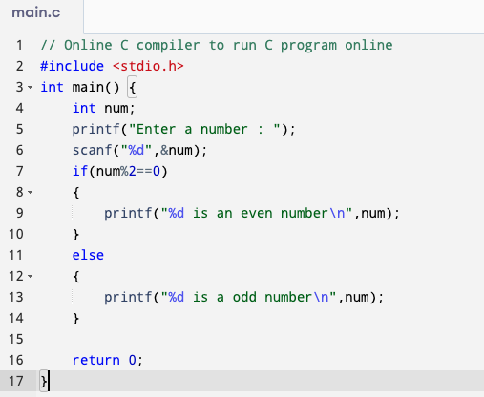
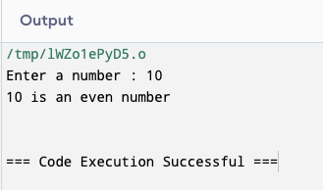
C Program to Check for Odd or Even Number

Slide 5
Positive Number or Negative Number or Zero
Flowchart:
Start
Input num
Is num>0
Yes
Print positive number
No
Print negative number
Is num<0
Yes
No
Zero
End

Slide 6
Positive Number or Negative Number or Zero
Algorithm:
Start.
Input num.
Is num>0:
Yes, print positive number and end.
No, go to 4.
Is num<0:
Yes, print negative number and end.
No, go to 5.
Otherwise:
Print zero and end.

Slide 7
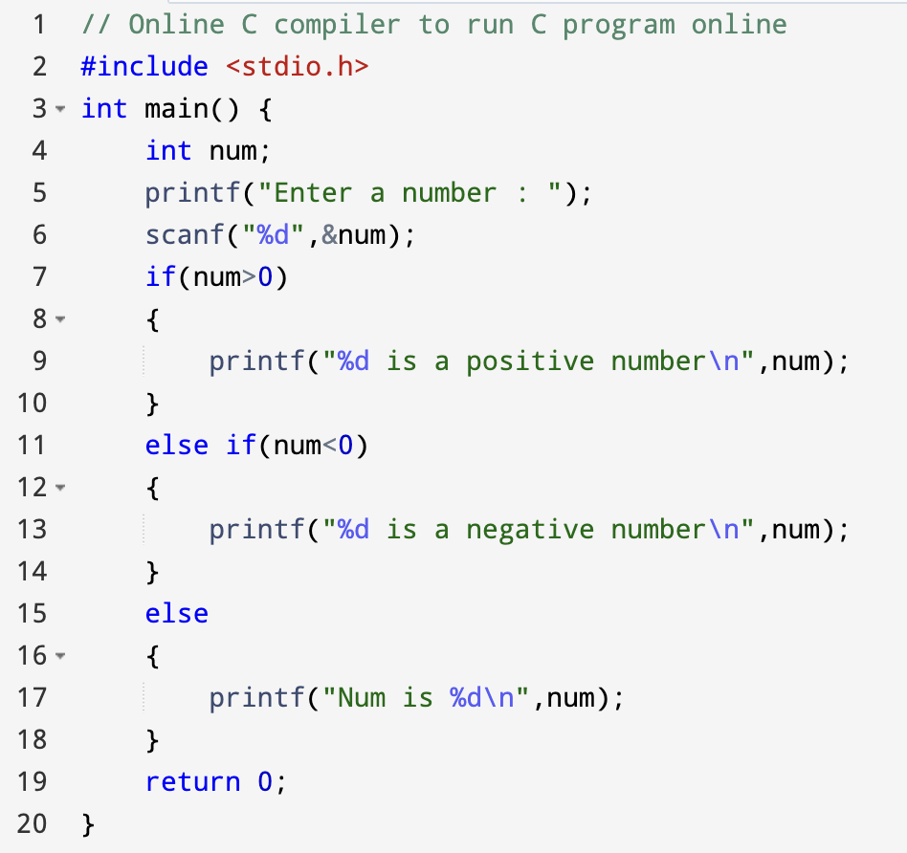
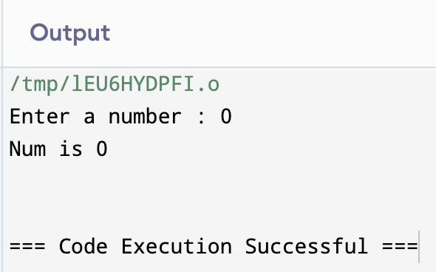
C Program to Check Positive Number or Negative Number or Zero

Slide 8
Find the larger of two numbers or determine if they are equal
Flowchart:
Start
Input num1,num2
Yes
Print num1 is maximum
Is num1>num2
No
Yes
Is num2>num1
Print num2 is maximum
No
Print they are equal
End

Slide 9
Find the larger of two numbers or determine if they are equal
Algorithm:
Start
Input num1, num2
Is num1 > num2:
Yes, print num1 is maximum and end.
No, go to next step
Is num2 > num1:
Yes, print num2 is maximum and end.
No, go to next step
Otherwise:
Print they are equal and end.

Slide 10
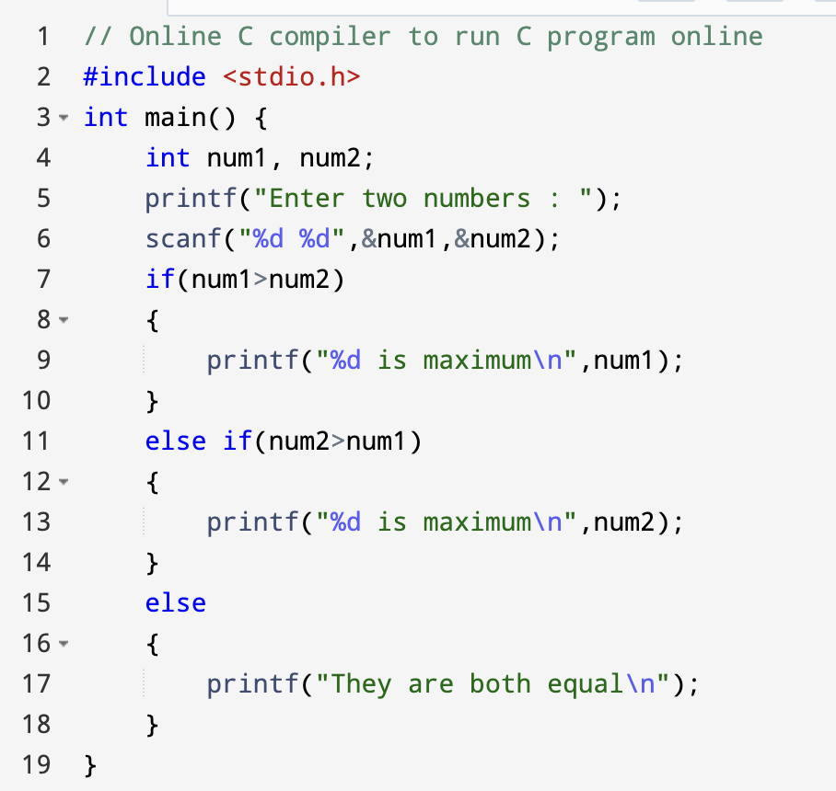
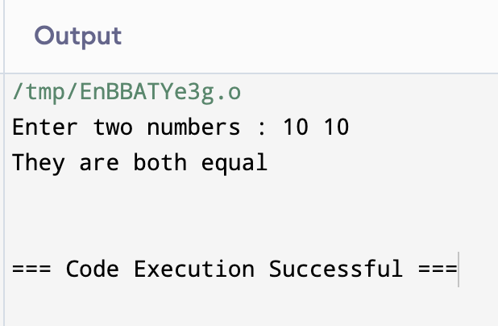
C program to find the larger of two numbers or determine if they are equal

Slide 11
Find the smaller of two numbers or determine if they are equal
Flowchart:
Start
Input num1,num2
Yes
Print num1 is minimum
Is num1<num2
No
Yes
Is num2<num1
Print num2 is minimum
No
Print they are equal
End

Slide 12
Find the smaller of two numbers or determine if they are equal
Algorithm:
Start
Input num1, num2
Is num1 < num2:
Yes, print num1 is minimum and end.
No, go to next step
Is num2 < num1:
Yes, print num2 is minimum and end.
No, go to next step
Otherwise:
Print they are equal and end.

Slide 13
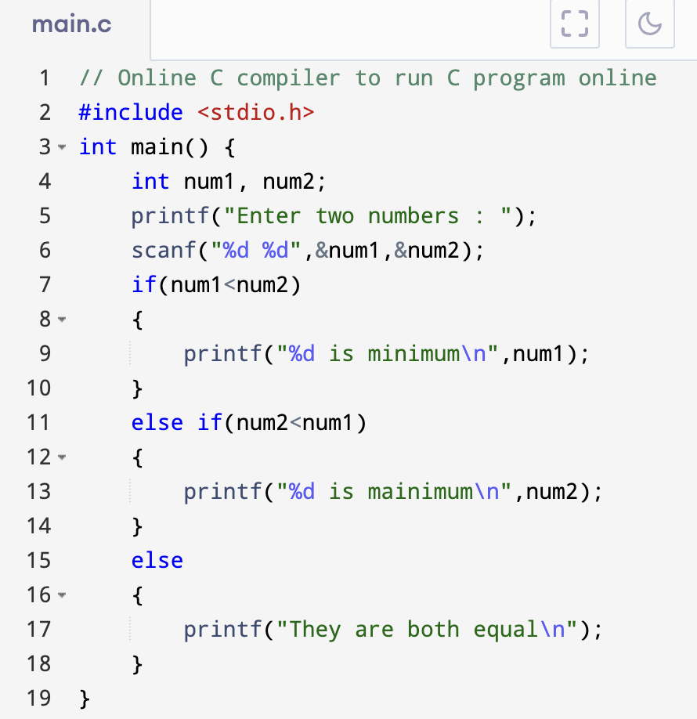
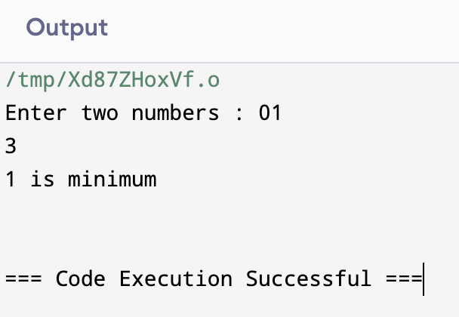
C program to find the smaller of two numbers or determine if they are equal

Slide 14
Find the maximum/minimum of three numbers
Flowchart:
Start
Input num1, num2, num3
Print num1 is maximum
Is (num1>num2) AND (num1>num3)
Yes
No
Is (num2>num1) AND (num2>num3)
Yes
Print num2 is maximum
No
Print num3 is maximum
End

Slide 15
Find the maximum/minimum of three numbers
Algorithm:
Start
Input num1, num2, num3
Is (num1>num2) AND (num1>num3)
Yes, print num1 is maximum and end
No, go to next step
Is (num2>num1) AND (num2>num3)
Yes, print num2 is maximum and end
No, go to next step
Otherwise
Print num3 is maximum and end

Slide 16
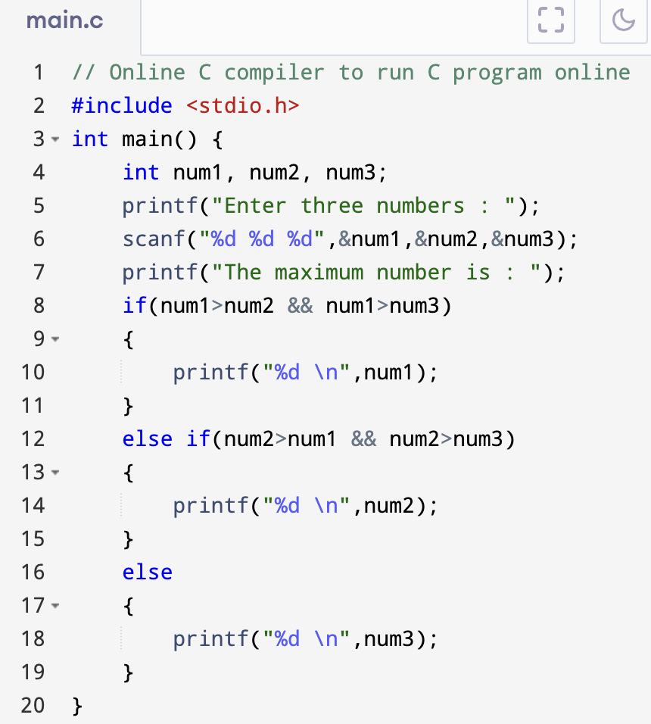
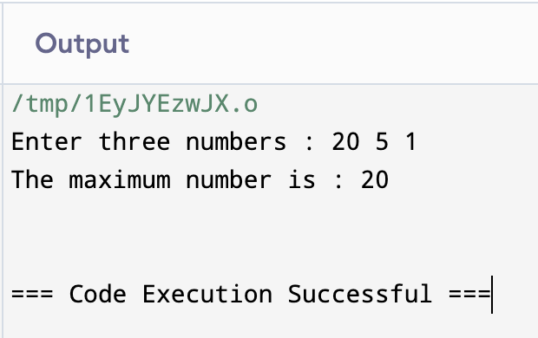
C program to find the maximum/minimum of three numbers

Slide 17
Check if a year is leap year or not
Flowchart:
Start
Input year
Is (year%400)==0
Yes
Print leap year
No
Is (year%4)==0 AND (year%100)!=0
Yes
Print leap year
No
Print not leap year
End

Slide 18
Check if a year is leap year or not
Algorithm:
Start
Input year
Is (year%400)==0
Yes, print leap year
No, go to next step
Is (year%4)==0 AND (year%100)!=0
Yes, print leap year
No, print not leap year
End

Slide 19
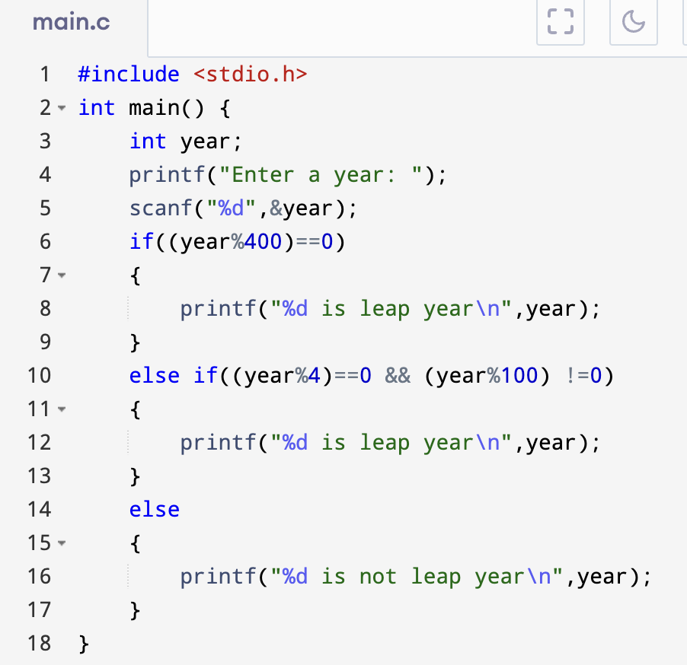
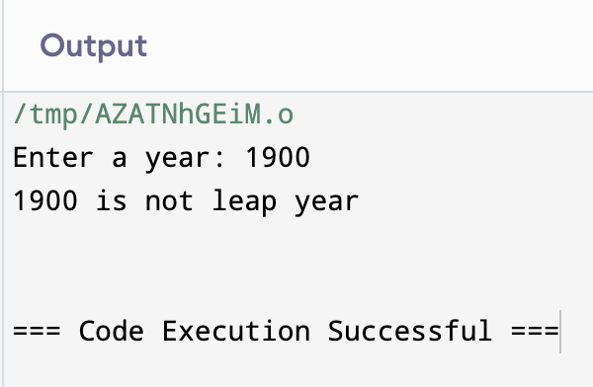
C program to check if a year is leap year or not

Slide 20
Check if a letter is capital or not
Flowchart:
Start
Input ch
Is (ch>=‘A’) AND (ch<=‘Z’)
Print capital letter
Yes
No
Is (ch>=‘a’) AND (ch<=‘z’)
Yes
Print small letter
No
Print not a letter
End

Slide 21
Check if a letter is capital or not
Algorithm:
Start
Input ch (ch is character)
Is (ch>=‘A’) AND (ch<=‘Z’)
Yes, print capital letter and end
No, go to next step
Is (ch>=‘a’) AND (ch<=‘z’)
Yes, print small letter and end
No, go to next step
Otherwise
Print not a letter and end

Slide 22
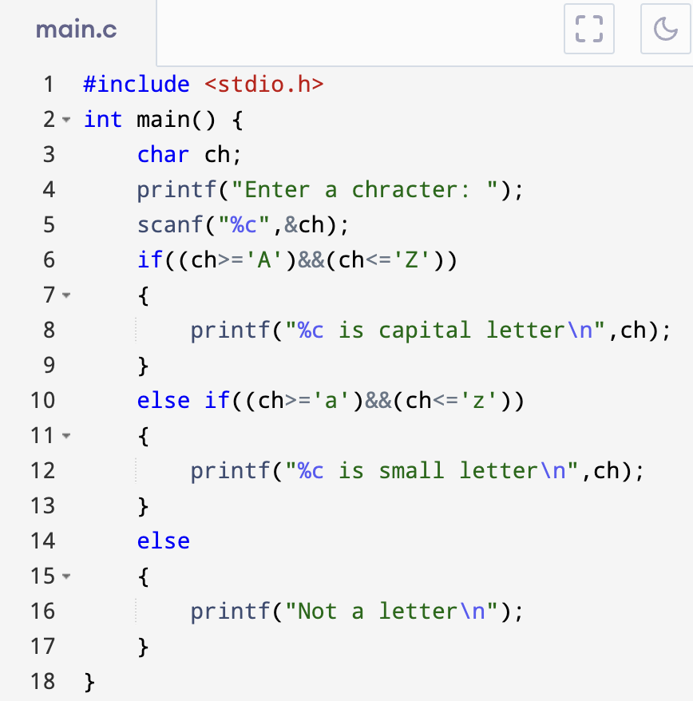
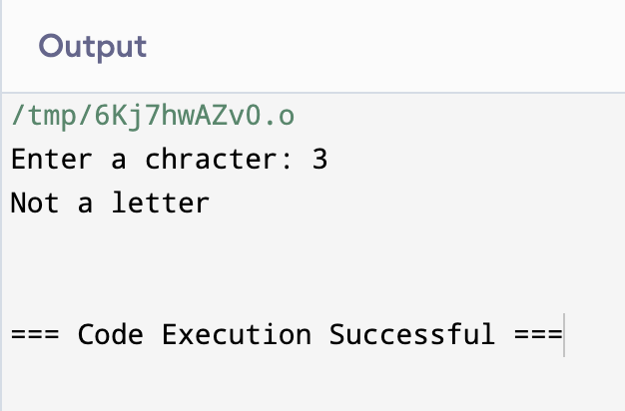
C program to check if a letter is capital or not

Slide 23
Check if a letter is vowel or consonant
Flowchart:
Start
Input ch
Is ((ch==‘A’) OR (ch==‘a) OR (ch==‘E’) OR (ch==‘e’) OR (ch==‘I’) OR (ch==‘i’) OR (ch==‘O’) OR (ch==‘o’) OR (ch==‘U’) OR (ch==‘u’))
Print vowel
Yes
No
Print consonant
End

Slide 24
Check if a letter is vowel or consonant
Algorithm:
Start
Input ch
Is (ch==‘A’) OR (ch==‘a) OR (ch==‘E’) OR (ch==‘e’) OR (ch==‘I’) OR (ch==‘i’) OR (ch==‘O’) OR (ch==‘o’) OR (ch==‘U’) OR (ch==‘u’):
Yes, print vowel
No, print consonat
End

Slide 25
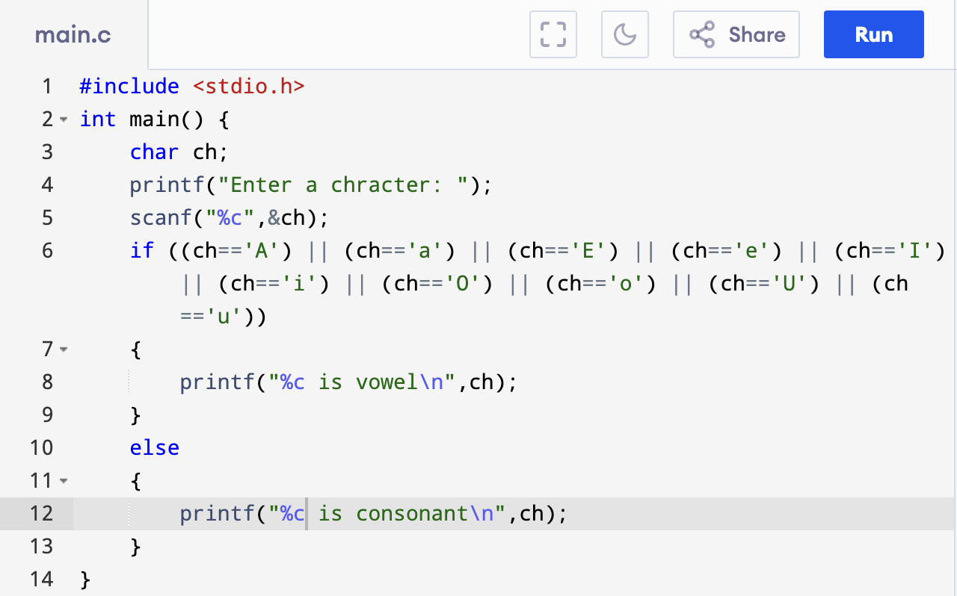
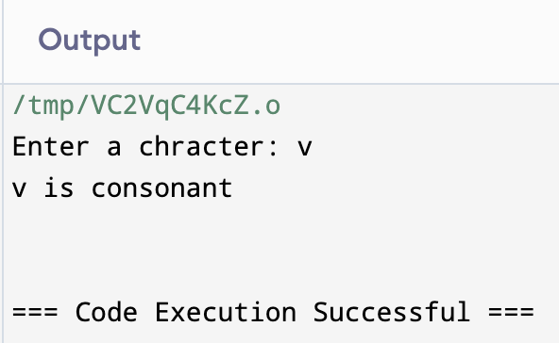
C program to check if a letter is vowel or consonant

Slide 26
Decide pass or fail from obtained marks
Flowchart:
Start
Input marks
Is marks>=33
Yes
Print pass
No
Print fail
End

Slide 27
Decide pass or fail from obtained marks
Algorithm:
Start
Input marks
Is marks>=33
Yes, print pass
No, print fail
End

Slide 28
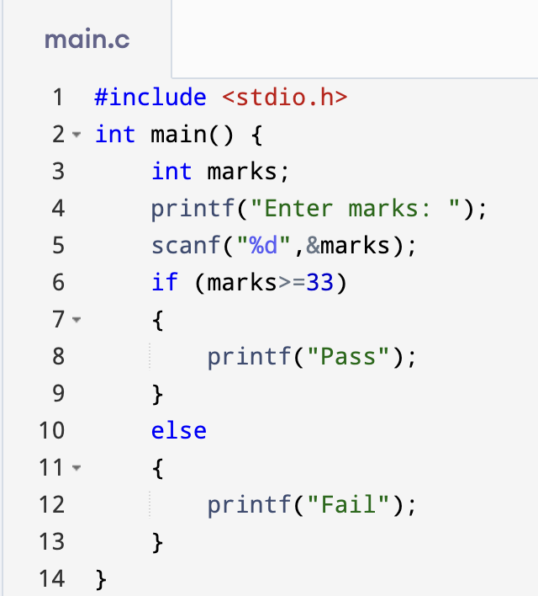
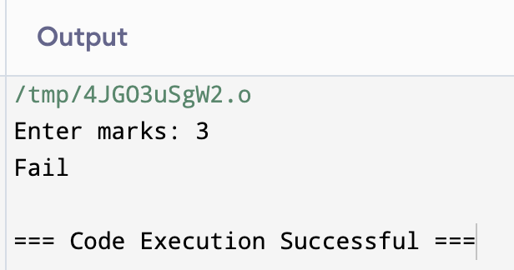
C program to decide pass or fail from obtained marks

Slide 29
Determine the letter grade from the obtained marks.
Flowchart:
Start
Input marks
Is marks>100 OR marks<0
Yes
Print Invalid marks
No
Is marks>=100 AND marks<=80
Yes
Print ‘A+’
No
Is marks>=40 AND marks<=44
Yes
Print ‘D’
No
Print ‘F’
End

Slide 30
Determine the letter grade from the obtained marks.
Algorithm:
Start
Input mark
Is (mark>100) OR (mark<0)
Yes, Invalid mark and end
No, go to next step
Is (mark>=80) AND (mark<=100)
Yes, print ‘A+’ and end
No, go to next step
Is (mark>=75) AND (mark<=79)
Yes, print ‘A’ and end
No, go to next step

Slide 31
Determine the letter grade from the obtained marks.
Algorithm
Cont’d:
Is (mark>=70) AND (mark<=74)
Yes, print ‘A-’ and end
No, go to next step
Is (mark>=65) AND (mark<=69)
Yes, print ‘B+’ and end
No, go to next step
Is (mark>=60) AND (mark<=64)
Yes, print ‘B’ and end
No, go to next step
Is (mark>=55) AND (mark<=59)
Yes, print ‘B-’ and end
No, go to next step

Slide 32
Determine the letter grade from the obtained marks.
Algorithm
Cont’d :
Is (mark>=50) AND (mark<=54)
Yes, print ‘C+’ and end
No, go to next step
Is (mark>=45) AND (mark<=49)
Yes, print ‘C’ and end
No, go to next step
Is (mark>=40) AND (mark<=44)
Yes, print ‘D’ and end
No, go to next step
Otherwise
Yes, print ‘F’ and end

Slide 33
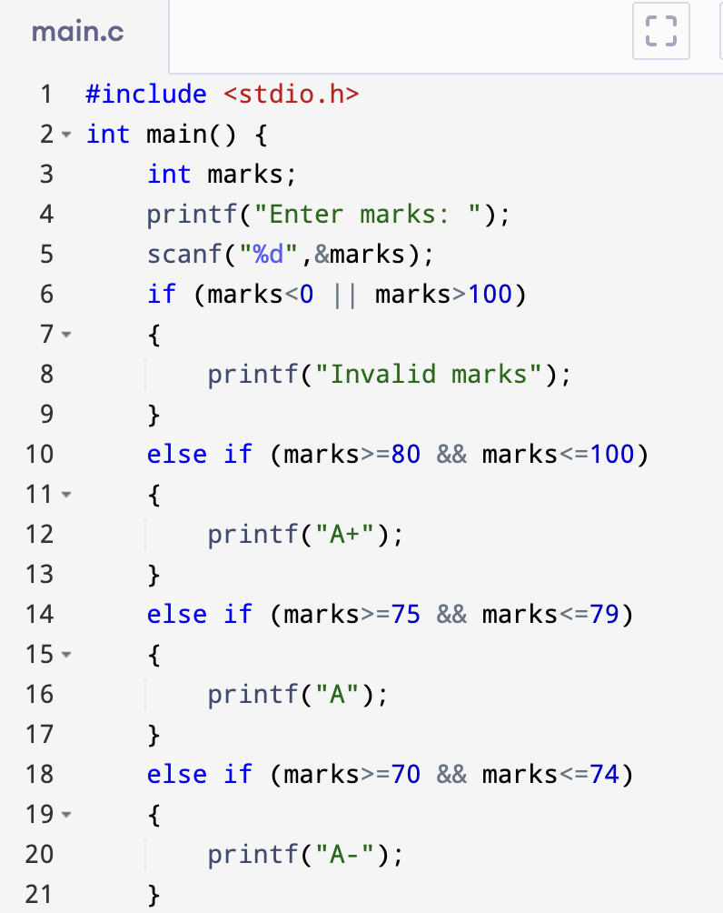
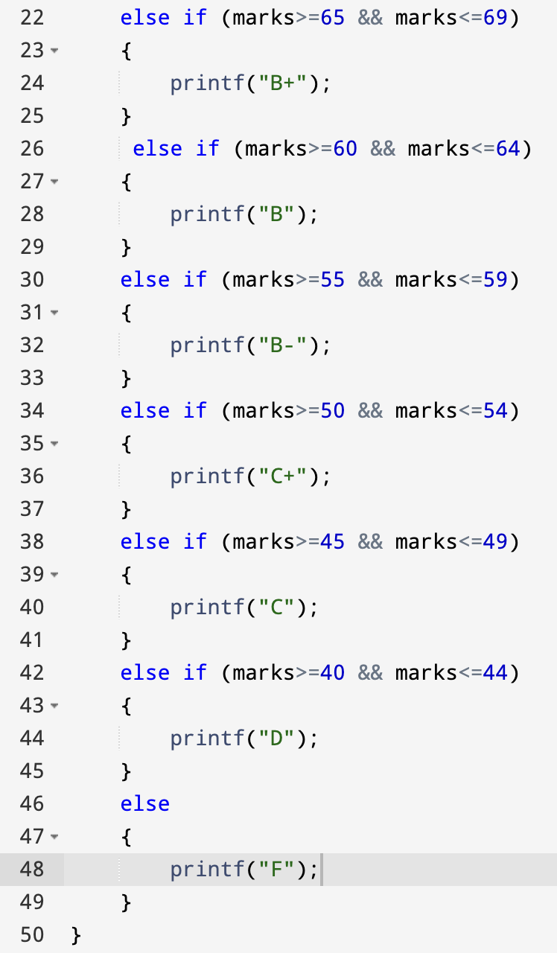
C program to find letter grade from obtained marks

Slide 34
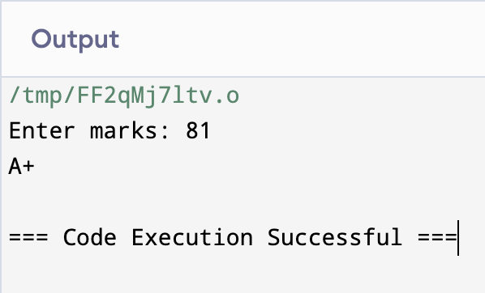
C program to find letter grade from obtained marks

Slide 35
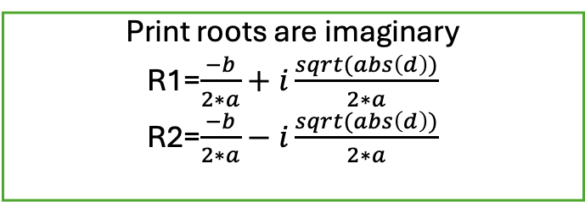
Find roots of a quadratic equation, ax²+bx+c.
Flowchart:
Start
Input 3 numbers (a,b,c)
Compute d <- b² -4ac
Compute
r1= -b+ sqrt(d)/(2*a)
r2= -b - sqrt(d)/(2*a)
Compute
r1= -b/(2*a)
r2= -b /(2*a)
Yes
Is d>0
No
Is d==0
Yes
No
Print roots are imaginary
R1=$\frac{−b}{2∗a}+i\frac{sqrt(abs\left(d\right))}{2∗a}$
R2=$\frac{−b}{2∗a}−i\frac{sqrt(abs\left(d\right))}{2∗a}$
Print r1, r2 values
Print r1, r2 values
Print r1, r2 values
Stop

Slide 36
Find roots of a quadratic equation, ax²+bx+c.
Algorithm:
Start
Input a,b,c
Calculate d=(b*b)-(4*a*c)
Is (d>0):
Yes, print roots are real and different.
r1= -b+ sqrt(d)/(2*a), r2= -b - sqrt(d)/(2*a).
print r1, r2 values and end.
No, go to next step.
Is (d==0):
Yes, print roots are real and same.
r1= -b/(2*a), r2= -b /(2*a).
print r1, r2 values and end.
No, go to next step.

Slide 37
Find roots of a quadratic equation, ax²+bx+c.
Algorithm
Cont’d :
Otherwise:
Yes, Print roots are imaginary.
r1=(−𝑏)/(2∗𝑎)+𝑖 (𝑠𝑞𝑟𝑡(𝑎𝑏𝑠(𝑑)))/(2∗𝑎),
r2=(−𝑏)/(2∗𝑎)−𝑖 (𝑠𝑞𝑟𝑡(𝑎𝑏𝑠(𝑑)))/(2∗𝑎) );
print r1, r2 values and end

Slide 38
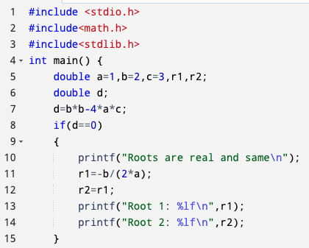
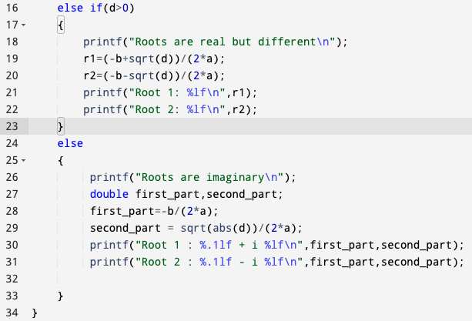
C program to find roots of a quadratic equation, ax²+bx+c.

Slide 39
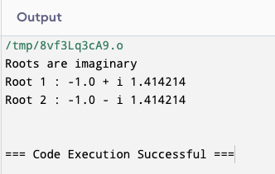
C program to find roots of a quadratic equation, ax²+bx+c.

Slide 40
Create a simple calculator
Flowchart:
Start
Input op
Input num1,num2
Switch op
Case ‘+’
Print n1,n2,n1+n2
Case ‘-’
Print n1,n2,n1-n2
default
Print not a valid operator
Stop

Slide 41
Create a simple calculator
Algorithm:
Declare local variables n1, n2, ch. For example, where n1 and n2 take two numeric values and ch variable define the operator symbols.
Enter the operator you chose for your operation and give two numbers.
Switch case jump to an operator selected by the user.
Display the operation result.
Exit from the program.

Slide 42
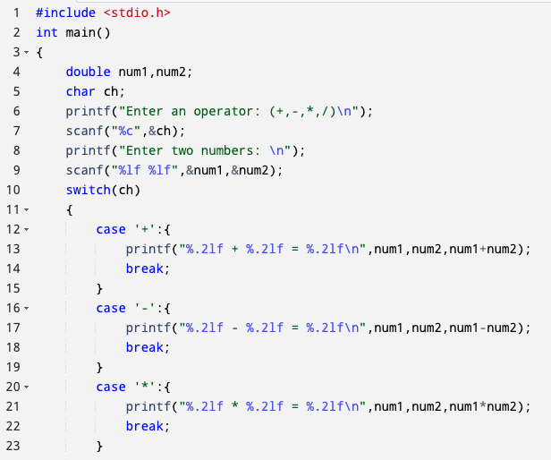
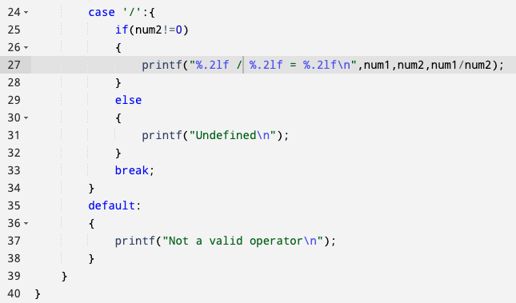
C program to create a simple calculator

Slide 43
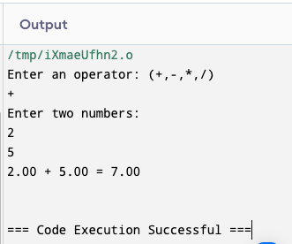
C program to create a simple calculator

Slide 44
Thank You

